Slide 1


F U N D A M E N T A L A N A L Y S I S T A T A E L X S I
------------

Slide 2

M A C R O E C O N O M I C F A C T O R S
INTEREST RATES
Current Rate: 6.5%
Previous Rate :
6.5%
INFLATION RATE
Current rate :
5.55%
Previous rate :
4.87%
GDP ANNUAL GROWTH RATE
Current Year Rate
7.60%
Previous Year Rate:
7.80%
GEO POLITICAL TENSIONS
Russia-Ukraine Conflict
Israel-Palestine war
Rising Oil Prices
2024 General Election

Slide 3

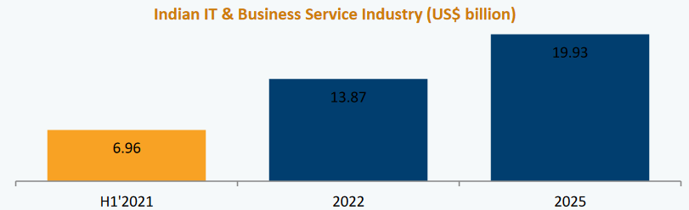
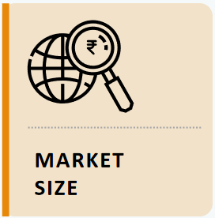
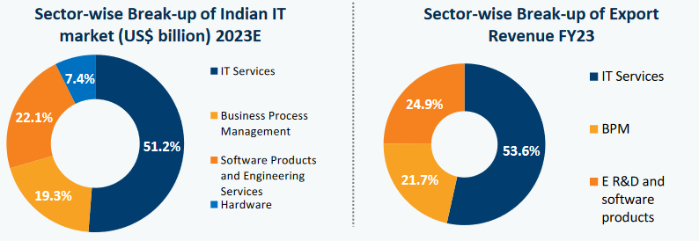

I N D U S T R Y A N A L Y S I S
SECTOR : INFORMATION TECHNOLOGY & BUSINESS PROCESS MANAGEMENT

Slide 4


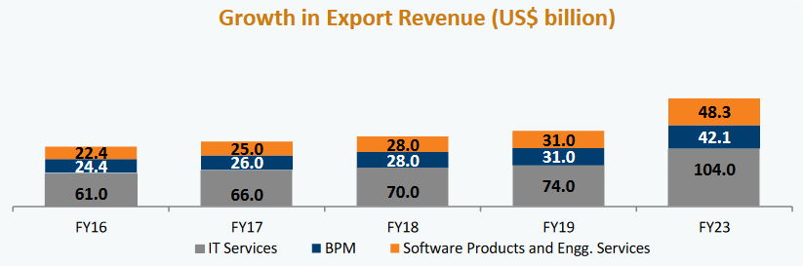
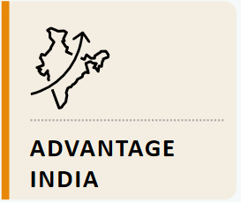


Growing Demand : Market projected to reach US$ 19.93 billion by 2025
Global Footprint : Indian IT firms have presence across the globe
Policy Support : Total budgetary allocation for the sector in the 2023-
24 is US$11.8 Billion.
Competitive Edge : Skilled IT professionals , FDI inflow of US$95.88
billion between 2000 to 2023.

Slide 5





F U N D A M E N T A L A N A L Y S I S
Name: Tata Elxsi Limited
Exchange: BSE
Founded: 1989
Industry: Systems Software
Sector: Software
Market Cap: ₹558.788b
Shares Outstanding: 62.28m
Current Market Price: ₹9054

Slide 6

S W O T A N A L Y S I S
STRENGTH
Increasing profit margins
Company with no debt
Near 52 week high
Consistent High Return stock over 5 years in NIFTY500
Increasing Revenue in every quarter
WEAKNESS
Declining Cashflows
Stock falls in Sell zone
OPPORTUNITY
Rapid growth of AI
Increased Market share
Mutual funds increased Holdings
THREATS
High PE ratio
Increased Competition
High Volatility

Slide 7

F U T U R E P R O S P E C T S
Tata Elxsi is forecast to grow earnings and revenue by 13.1% and 13.3% per annum respectively. EPS is expected to grow by 13% per annum. Return on equity is forecast to be 31.1% in 3 years.
Date | Revenue | Earnings | Free Cash Flow | Cash from Op | Avg. No. Analysts
31/3/2026 | 49,082 | 11,241 | 8,160 | 11,075 | 7
31/3/2025 | 42,652 | 9,808 | 7,450 | 9,563 | 9
31/3/2024 | 36,116 | 8,192 | 7,886 | 9,933 | 9
30/9/2023 | 33,941 | 7,851 | 5,766 | 6,401 | N/A
Date | EPS * | EPS High Estimate | EPS Low Estimate | Avg. No. Analysts
31/3/2024 | 131.16 | 138.67 | 125 | 8
31/3/2025 | 157.04 | 169.31 | 139.3 | 8
31/3/2026 | 179.67 | 201.9 | 154.3 | 6

Slide 8

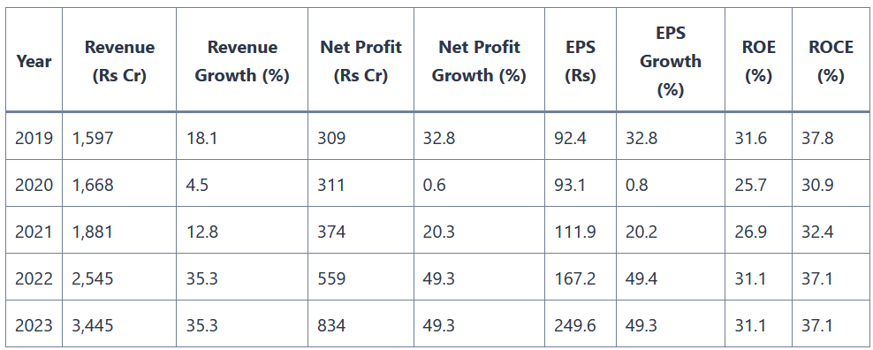
F I N A N C I A L S & R A T I O A N A L Y S I S

Slide 9

P / E V A L U A T I O N
COMMON SIZE STATEMENT
Narration
Income
Sales
Expenses
Operating Profit
Other Income
Revenue
Expenses
Depreciation
Interest
Total Expenses
Profit before tax
Tax
Net profit
EPS
Price to earnings
19.21% | 20%
72.08% | 73%
27.92% | 27%
2.49% | 2%
30.41%
2.49% | 2%
0.37% | 0.37%
27.41%
 | 25%
20.58% | 19.97%
FORECAST
MARCH '24 | MARCH '25 | MARCH '26
3,773.66 | 4,528.40 | 5,434.08
2,754.77 | 3,305.73 | 3,966.88
1,018.89 | 1,222.67 | 1,467.20
75.47 | 90.57 | 108.68
1,094.36 | 1,313.24 | 1,575.88
75.47 | 90.57 | 108.68
13.96 | 16.76 | 20.11
89.44 | 107.32 | 128.79
1,004.93 | 1,205.91 | 1,447.09
251.23 | 301.48 | 361.77
753.70 | 904.43 | 1,085.32
121.03 | 145.23 | 174.28
69.13 | 57.61 | 48.00
No. of outstanding shares | 6.22758786
Average Price to Earnings | 46.19
EPS | 121.03
Intrinsic Value | 5,589.55
Current Market Price | 8366

Slide 10

F I N A L V E R D I C T
 |  | SENSITIVITY ANALYSIS
5,589.55 | 16% | 18% | 20% | 22% | 24%
77% | 4591.632 | 4670.798 | 4749.964 | 4829.1301 | 4908.296
75% | 4997.432 | 5083.595 | 5169.7576 | 5255.9202 | 5342.083
73% | 5403.233 | 5496.392 | 5589.5512 | 5682.7103 | 5775.87
71% | 5809.033 | 5909.189 | 6009.3447 | 6109.5005 | 6209.656
69% | 6214.834 | 6321.986 | 6429.1383 | 6536.2906 | 6643.443
ASSUMPTIONS
Stable Growth in terms of Revenue & Profit
Expense does not increase substantially
Ideal Market conditions
INTRINSIC VALUE < CURRENT MARKET PRICE
SHARE PRICE IS OVERVALUED
RECOMMENDATION : NO TO BUY / SELL

